Slide 1
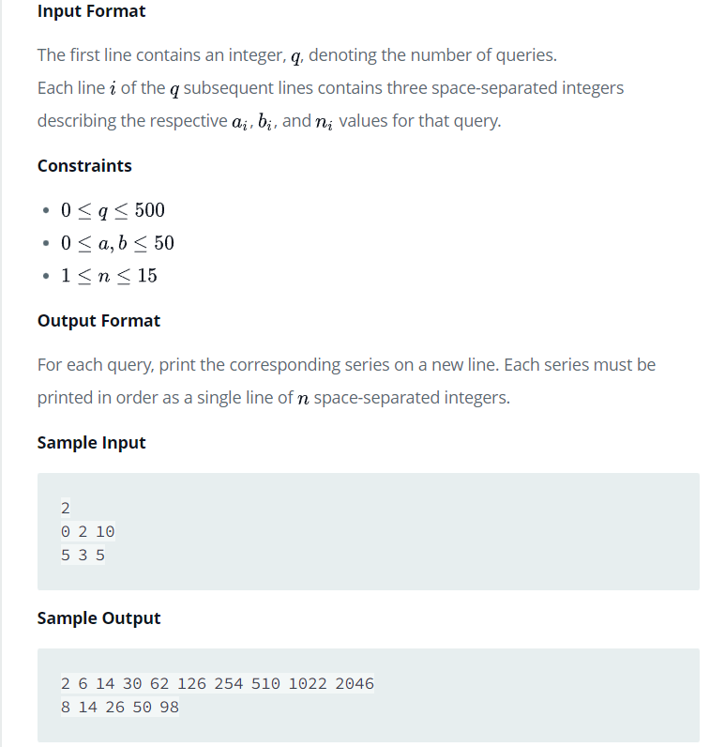
Problem 7 From HackerRank- Java Loops II

Slide 2
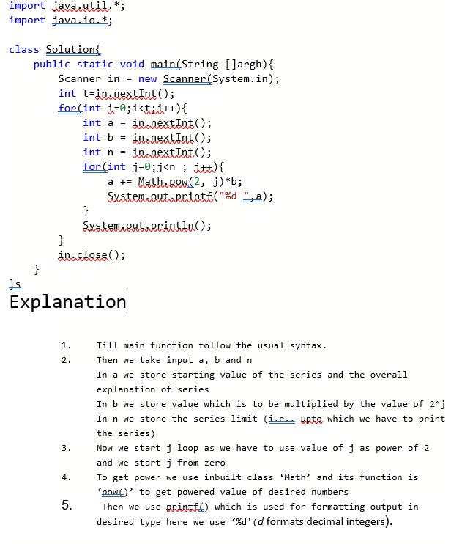
Problem 7 solution with explanation

Slide 3
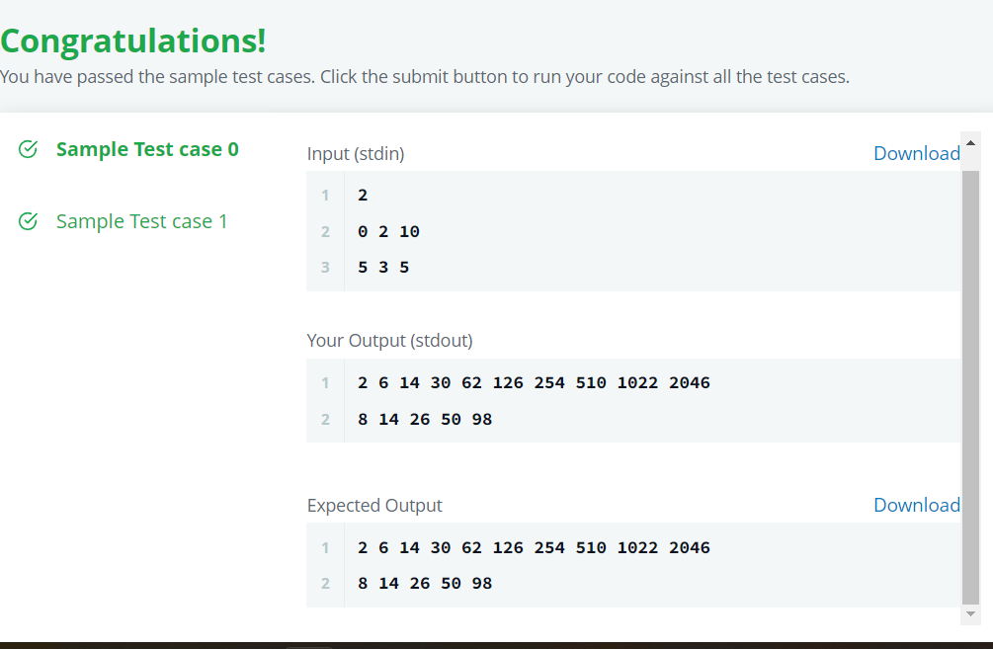
Output 7th problem

Slide 4
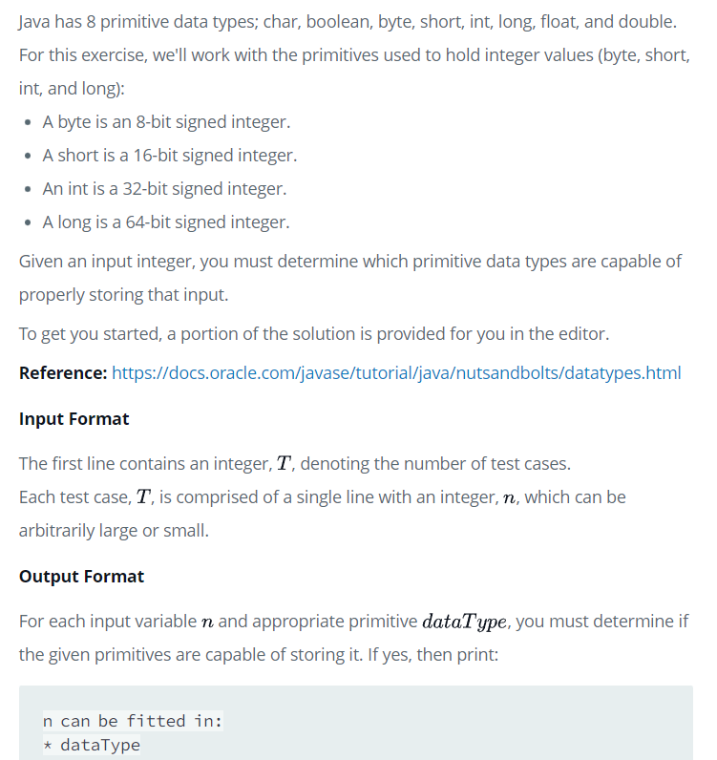
Problem 8th from HackerRank -Java Datatypes

Slide 5
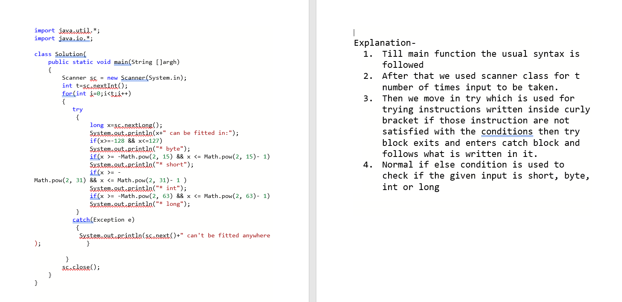
Solution 8th with Explanation-

Slide 6
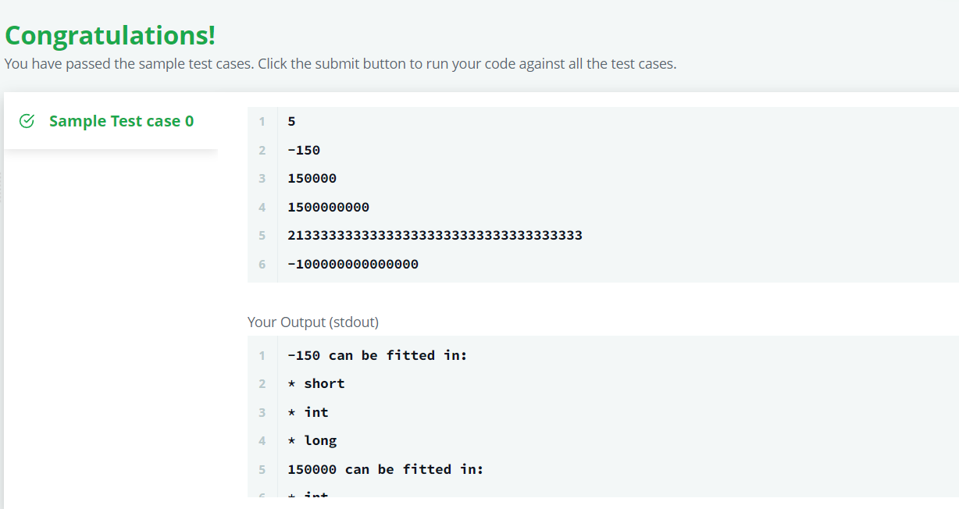
Output 8-

Slide 7
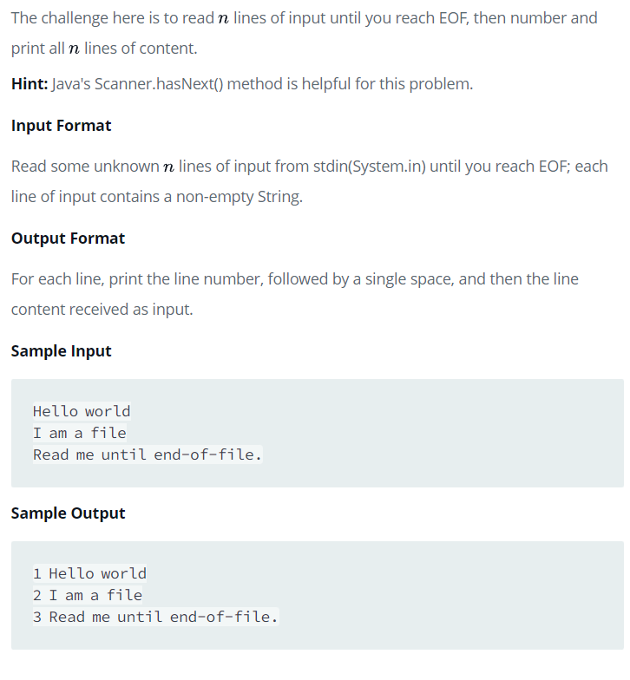
Problem 9- Java End-of-File

Slide 8
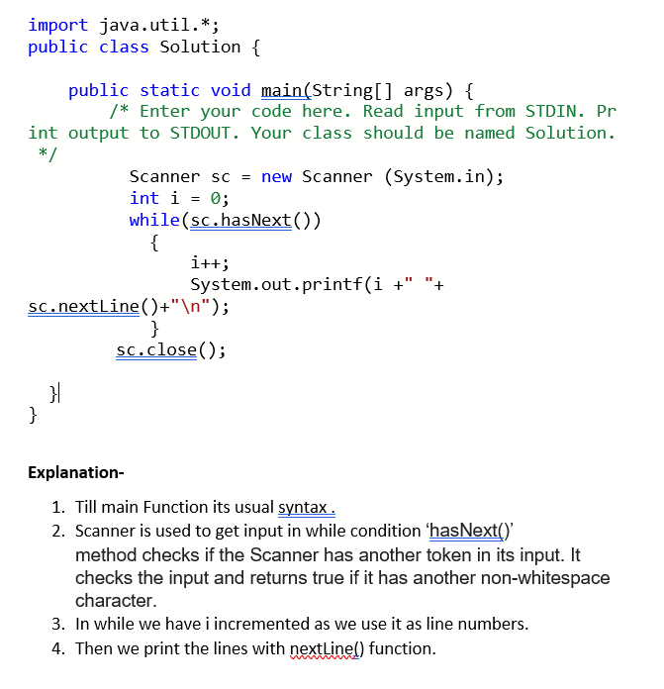
Solution 9th with Explanation-

Slide 9
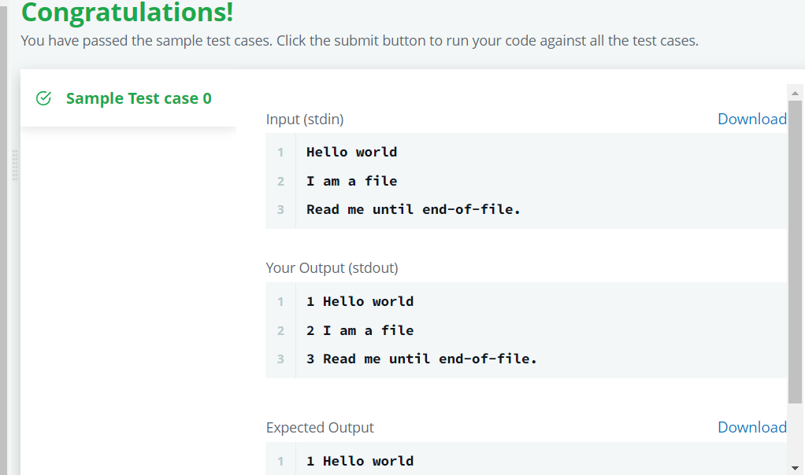
Output 9-

